Slide 1
360-DEGREE WEB CONFERENCING DEVICE

Slide 2
What are we doing?

Slide 3
Scope
A 360-degree camera system for web conferencing, allowing clients to focus on the appropriate parties based on sound localisation.

Slide 4

Who are we?

Slide 5
Responsibilities
Sub-teams | Team Members
Sound (Direction of Arrival) | Josh, Jose
I/O (File Conversion) | Link, Jordan, Ben
Image (Processing) | Link, Jordan, Ben
Assembly (Modelling/Manufacturing) | Minh, Jireh
Documentation | Minh, Jireh

Slide 6
What do we have?

Slide 7
Requirements
Requirement | Description | Ranking
R1 | Portability | 5
R2 | Video Output | 2
R3 | Audio Output | 5
R4 | Cost | 3
R5 | Ease of Use | 1
R6 | Video Interface | 2
R7 | Simple Assembly | 6
R8 | Upgradability | 4

Slide 8


Finance
CECS Funding - $100
Client Funding - $200

Slide 9
How do we do it?

Slide 10
Initial Project Timeline
Component Acquisition (Week 3)
Synchronization (Week 6)
Video Switching (Week 6)
Noise Cancellation (Week 7)
Interface Design (Week 7)
Optimization (Week 8)
Testing (Week 10)
Camera Setup (Week 5)
Funding (Week 4)
Conceptual Prototype (Week 4)
Methodology (Week 4)
DOA Algorithm (Week 4)
Prototype Assembly (Week 8)
Handover Document (Week 11)

Slide 11
Risks & Contingencies
Failure to Meet Deadlines | Over Budget | Incompatible Integration | Damaged/Loss of Components | Delay Deliveries
* Inform other team members about problems in advance. * Discussion of a new deadline with team and client. * If unable to extend the deadline, the impact of failure must be considered. * Provide support to students to complete the task. | * Notify the client the project is over budget *Discussion with other team members to see where cost can be reduced *Provide budget updates to client | * Discuss with members managing the different subsystems *Change the subsystems when necessary if cheaper to modify | * Determine the fastest method to obtain replacement *Replace the component and notify the client and team of purchases | *Contact the seller for a delivery update *Purchase the component from a different seller *Retain the other component as backup or resell to recover funds

Slide 12
What have we done?

Slide 13
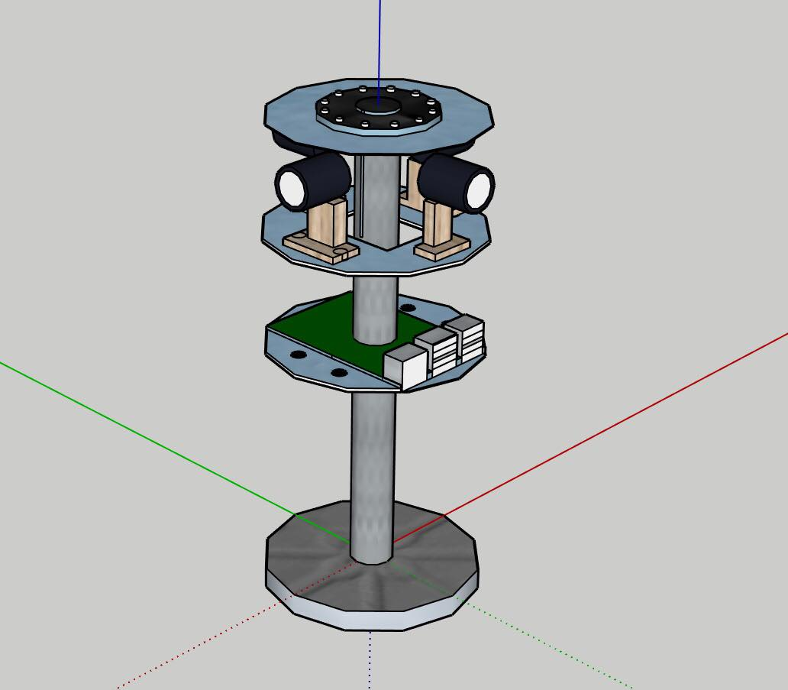
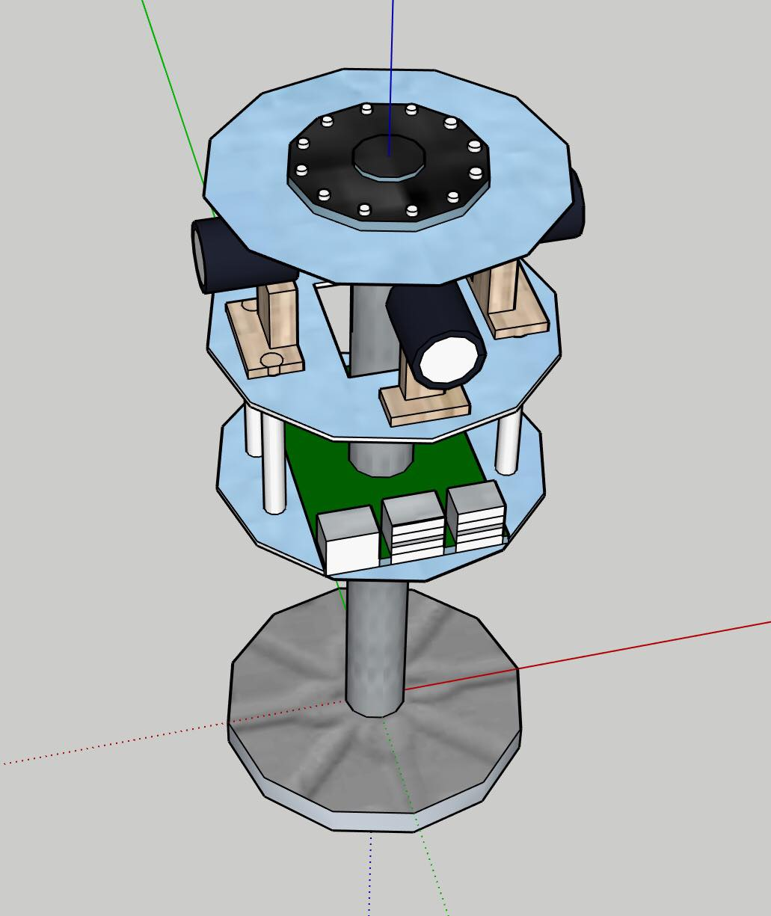
Visualization

Slide 14
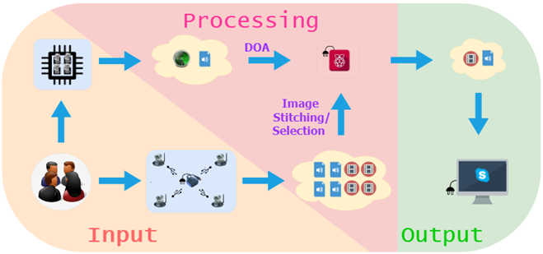
Concept

Slide 15
Questions?

Slide 16

Thank you!

